Slide 1

Price Elasticity of Demand (PED)
1.1.4 Elasticity

Slide 2

Learning objectives
Definition of PED.
Formula of PED.
Calculate the PED using given percentage changes in quantity demanded and percentage changes in price.
The use of diagrams to show price elastic and price inelastic demand.
Interpret numerical values of PED
Today you will learn…

Slide 3


Prices on the rise! - Discuss
If the price of these two products go up, how much will demand for the product change? Why? How would this affect the demand curve?

Slide 4

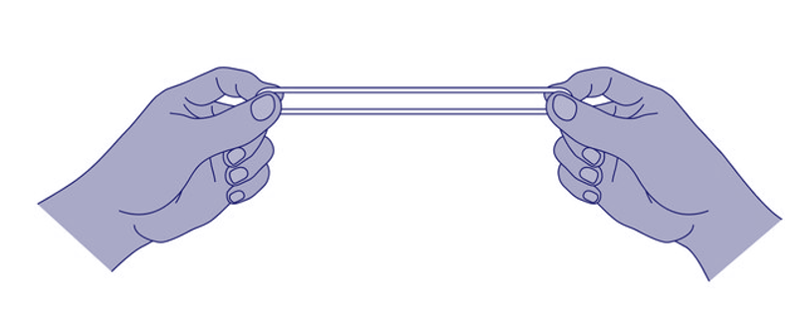
Price elasticity of demand
Price elasticity of demand - how much the quantity demanded of a product changes following a change in price
If it’s elastic, does the quantity demanded change a lot or a little?
If it’s inelastic (not elastic) does the
quantity demanded change a lot or a little?

Slide 5
Definitions
A good can be price elastic - a change in price results in a proportionately greater change in quantity demanded.
E.g. Price increases 5% but Quantity decreases 10%
OR
A good can be price inelastic - a change in price results in a proportionately smaller change in the quantity demanded.
E.g. Price increases by 20% but Quantity decreases by 10%

Slide 6
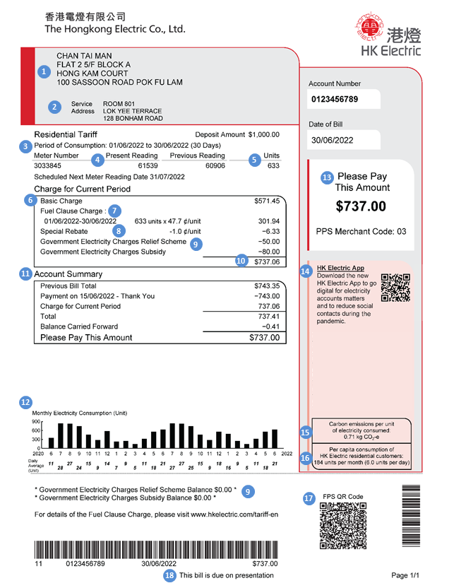
Consider this
The Chow family received their electricity bill for the previous 3 months. It had increased by 13% from HK$1,800 to HK$2,034. The reasons for the increase was a price rise by the supplier, not because they used more electricity.
Mr. Chow mentioned this increase to his family suggesting that everyone tried to ‘economise’ when using electrical appliances. Everyone agreed but Mr. Chow suspected that this would probably not make much of a change and therefore not make much difference in the next bill.
Indeed, when the next bill arrived, the bill had gone down but only slightly to HK$2,002. Why do you think that is?

Slide 7




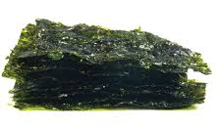
How do you think the demand for these products would be affected if the price went up or down?
Notes:
Inelastic - cigarettes, petrol, rice.

Slide 8
Factors affecting PED
Availability of substitutes
  Consumers can switch easily from one product to another - demand is elastic
Degree of necessity
  ‘Essential’ goods have inelastic demand. Consumers demand will not change even if the price changes.
Proportion of income spent on a product
  Consumers may wait and see if the price drops on high value products before they buy - demand will be elastic. If products costs very little, like pens, prices are inelastic.
Time
  In the short term goods have inelastic demand because it may take time to find substitutes. In the long term demand will be more elastic as alternative products will exist.

Slide 9
Sorting activity
Sort the goods into inelastic or elastic goods.
Google Doc
Notes:
Cut this out.https://docs.google.com/document/d/1CMAJU0WoQuobKi7_hQOR6_6IMRZsOJhEs4x-4uKGTo0/edit#heading=h.gjdgxs
Easier version - print these tables - have words on the board. https://docs.google.com/document/d/1ilwCK06CMOlaOyCMFPjARpeY-DgvUPTUiI6DpRpQz1Q/edit

Slide 10
How do you think the demand curves for the different products would differ?
Price
Quantity

Slide 11
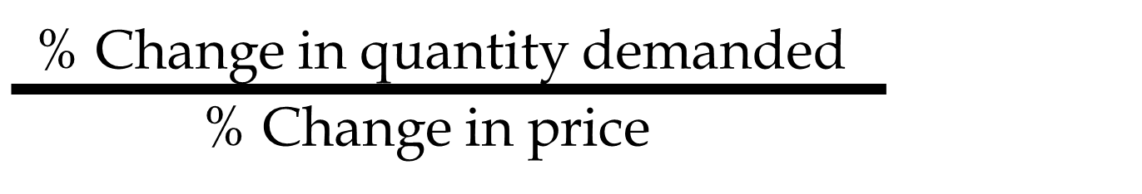
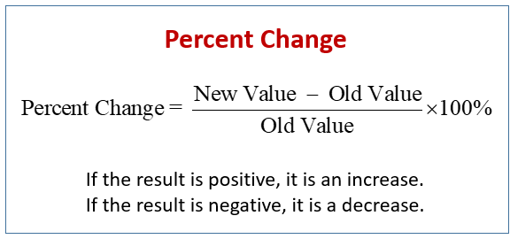
Price elasticity of demand can be calculated
PED formula

Slide 12
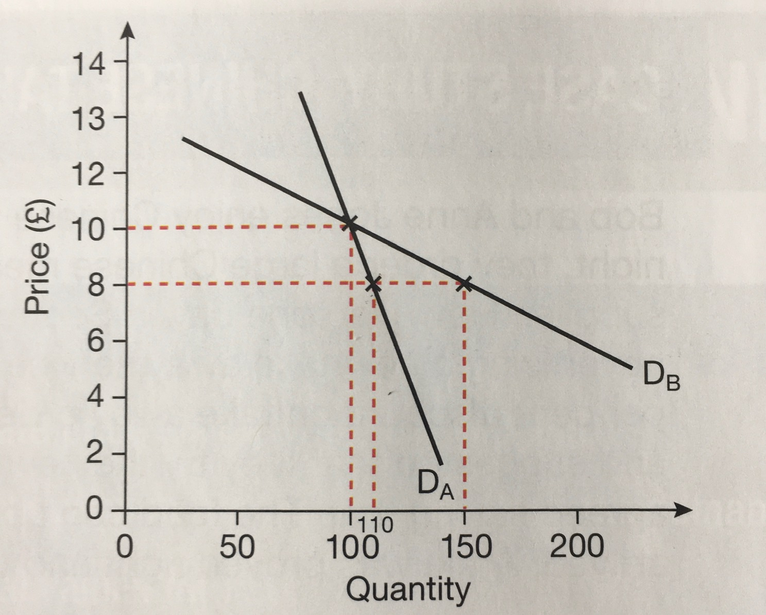
An example...
Product A.
Quantity & price changes from ? to ?
Percentage change - quantity & price?
PED change?
Product B
Quantity & price changes from ? to ?
Percentage change - quantity & price?
PED change?

Slide 13
This means...
When the PED value is less than 1, demand is said to be inelastic.
Demand for Product A is price inelastic being -0.5
A curve on the diagram would be steep.
When the PED values i greater than 1, demand is said to be elastic.
Demand for product B is price elastic being -2.5
A curve on a diagram would be flatter.

Slide 14
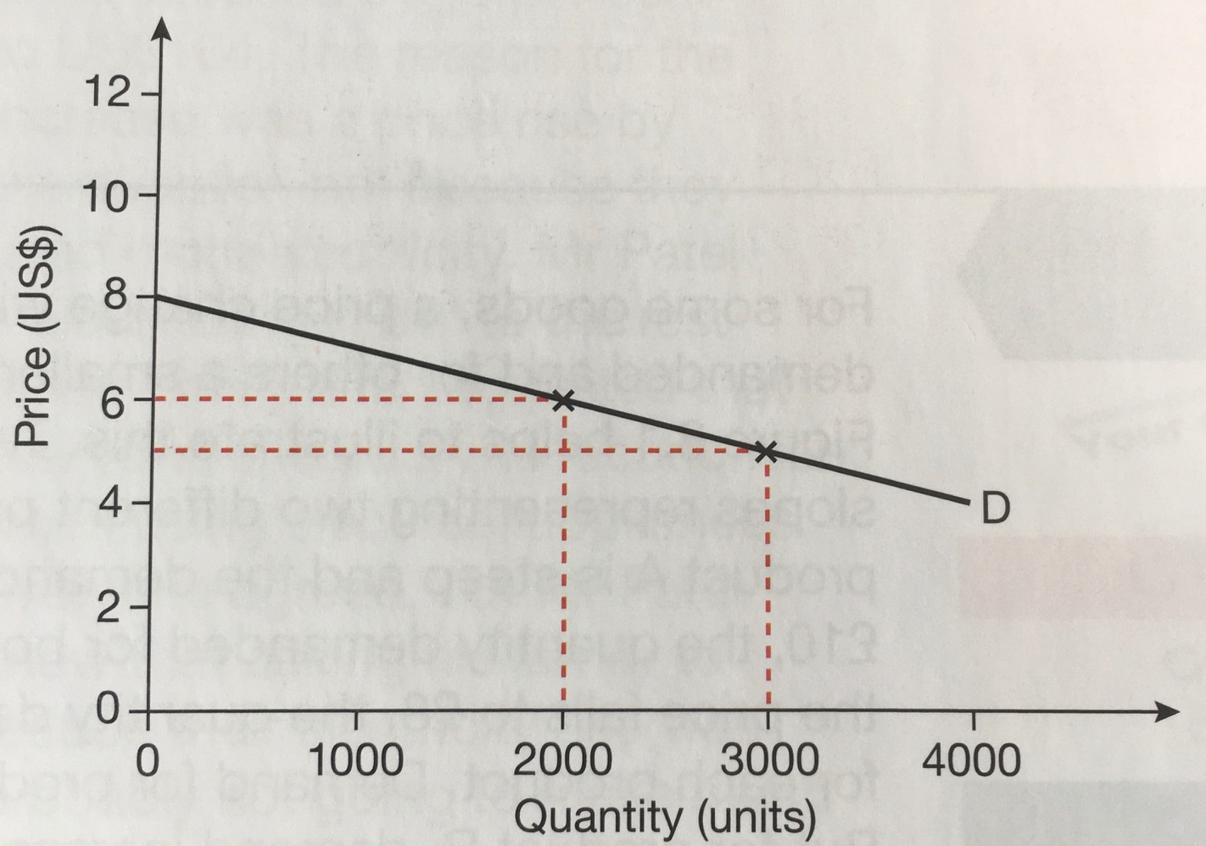
What happens here?
Quantity & price changes from ? to ?
Percentage change - quantity & price?
PED change?
What is meant by elastic / inelastic demand. Use the example in your explanation.

Slide 15
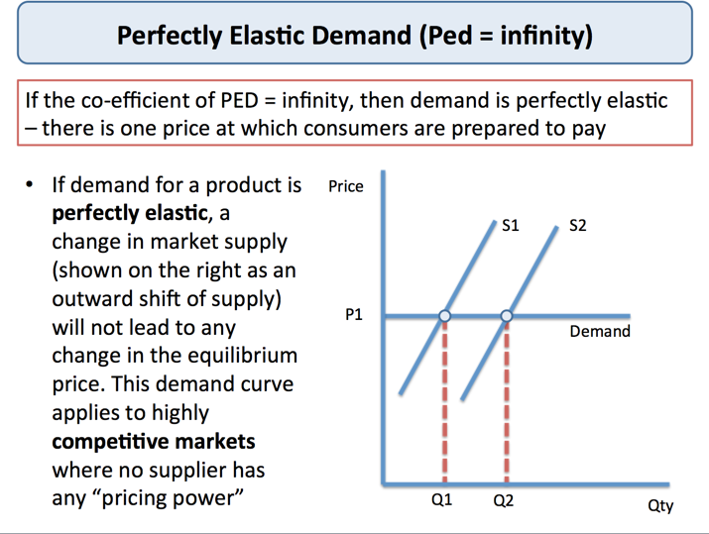

Slide 16
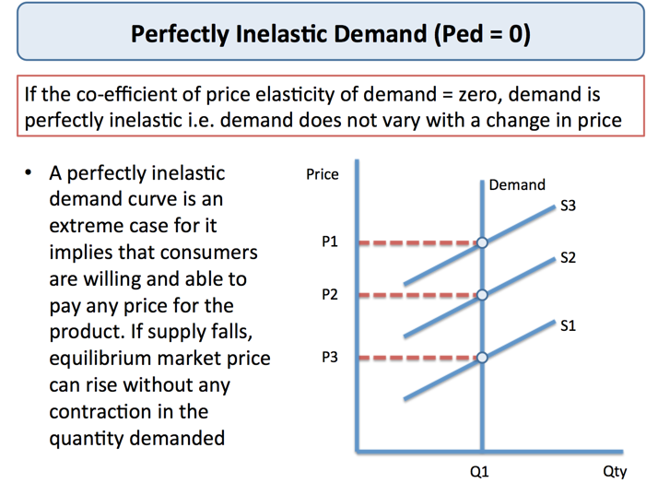

Slide 17
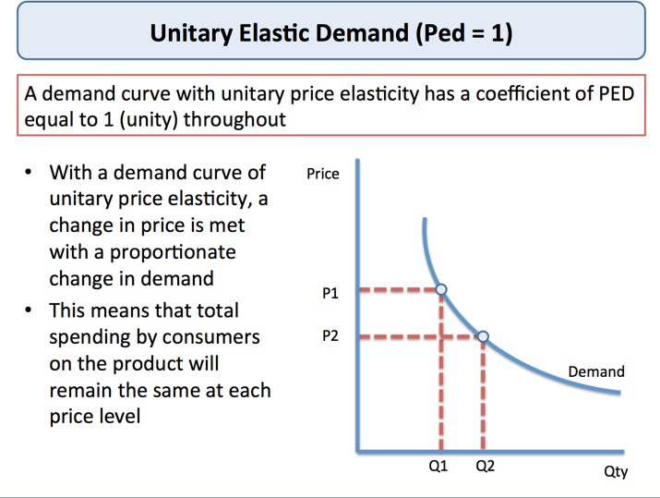
PED = -1

Slide 18
Your turn!
Complete the worksheets provided.

Slide 19
Over to you...
Calculate these examples.

Slide 20
Results are
Example 1
The price increases from $20 to $22. Therefore % change = 2/20 = 0.1 (10%)
0.1 = 10% (0.1 *100)
Quantity fell by 13/100 = – 0.13 (13%)
Therefore PED = 13/-10
Therefore PED = -1.3
Example 2
Price rises from $15 to $30 (100% rise in price)
Quantity falls from 100 to 80 (20% fall)
PED – -20/100 = -0.2

Slide 21
Results are
Example 3
In this case the PED
% change in QD = -50/100 = 0.5 = -50%
% change in price =10/50 = 0.2 = 20%
Therefore PED = -2.5
Example 4
PED = -10/40 = -0.25

Slide 22
New key terms - theoretic only
  perfectly inelastic
  perfectly elastic
  unitary elasticity.

Slide 23
New key terms
Perfectly inelastic - demand where PED = 0
A change in price results in no change in the quantity demanded.
Perfectly inelastic - e.g. if there are no substitutes available - eg insulin to a diabetic.
Perfectly inelastic - what would it look like in a graph?

Slide 24
Perfectly inelastic

Slide 25
New key terms
Perfectly elastic - demand where PED = ∞
An increase in price will result in zero demand. There is only one price consumers are willing to pay.
Perfectly elastic is very extreme and highly unlikely. Wet markets in HK - if any vendor would increase their price people would buy from the competitor.
Perfectly elastic - what would it look like in a graph?

Slide 26
Perfectly elastic

Slide 27
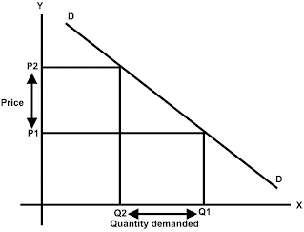
New key terms
Unitary elasticity PED = -1
The responsiveness of demand is proportionately equal to the change in price.
The price of digital cameras increases by 10%, the quantity of digital cameras demanded decreases by 10%

Slide 28
This means...
When the PED value is less than 1, demand is said to be inelastic.
Demand for Product A is price inelastic being -0.5
When the PED values i greater than 1, demand is said to be elastic.
Demand for product B is price elastic being -2.5
If the PED value is zero demand is said to be perfectly inelastic - a change in price will result in no change in the quantity demanded.
If PED is equal to infinity demand is said to be perfectly elastic
If PED is exactly -1, demand is said to be unitary elastic

Slide 29
Values of PED | How is the demand called? | What does it mean?
PED > 1 | Price elastic demand | A change in price leads to a proportionately greater change in the quantity demanded.
0<PED<1 | Price inelastic demand | A change in price leads to a proportionately smaller change in the quantity demanded.
PED = 1 | Unitary elastic demand | A change in price leads to a proportionately equal change in the quantity demanded.
PED = 0 | Perfectly inelastic demand | A change in price leads to no change in the quantity demanded.
PED = ∞ | Perfectly elastic demand | A tiny change in price would lead to an infinite change in the quantity demanded.

Slide 30
PED and total revenue

Slide 31

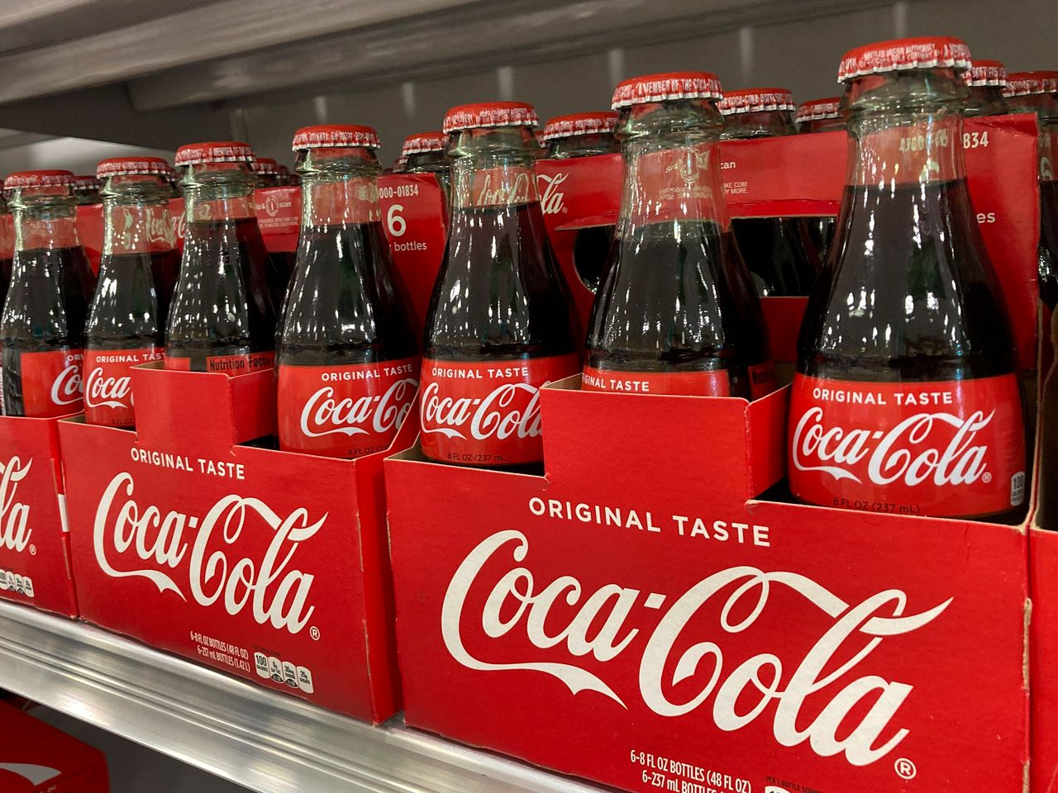
PED of these products?
Is a higher price or lower price better for Oil producers? Consider PED and the change in Quantity demanded.
Is a higher price or a lower price better for The Coca Cola Company? Consider PED and the change in Quantity demanded.

Slide 32
The importance of PED on businesses
How do you calculate the total income from a business?
Total revenue = quantity sold x price
Why would PED be important for a business?

Slide 33
Example
What is the revenue for product A at both prices?
What is the revenue for product B at both prices?

Slide 34
Activity
IGCSE Econ 1.1.4a Price Elasticity of Demand - effect on total revenue

Slide 35
Summary of total revenue for different elasticities
Price Elasticity | Value | Price Change | Effect on TR
Inelastic | < 1 | Decrease | Fall
Inelastic | < 1 | Increase | Rise
Elastic | > 1 | Decrease | Rise
Elastic | > 1 | Increase | Fall

Slide 36
Type of demand | Definition | Sign | Impact on revenue of price increase
perfectly elastic | An increase in price will result in zero demand | infinity | decreases to zero
perfectly inelastic | A change in price will result in no change in the quantity demanded | 0 | increases
unitary elasticity | The responsiveness of demand is proportionately equal to the change in price | 1 | constant
elastic | Changes in price result in a greater change in the quantity demanded | between 1 and infinity | decreases
inelastic | Changes in price result in a proportionately smaller change in the quantity demanded | between 0 and 1 | increases

Slide 37
Learning objectives
Definition of PED.
Formula of PED.
Calculate the PED using given percentage changes in quantity demanded and percentage changes in price.
The use of diagrams to show price elastic and price inelastic demand.
Interpret numerical values of PED
Today you will learn…

